Slide 1



2021 Sony Open in Hawaii
Sustainability Initiatives
Notes:
The Sony Open in Hawaii is a special event that showcases golf talents against the backdrop of Hawaii’s natural beauty. Due to the COVID pandemic, the Sony Open in 2021 was held without spectators, but our team remained committed to the sustainability initiatives through a strong collaboration among the Friends of Hawaii Charities, Waialae Country Club, and Sony. The event has been certified as Green Event by the State of Hawaii every year since 2016 and we are very honored to be able to continue the tradition over the pandemic.

Slide 2
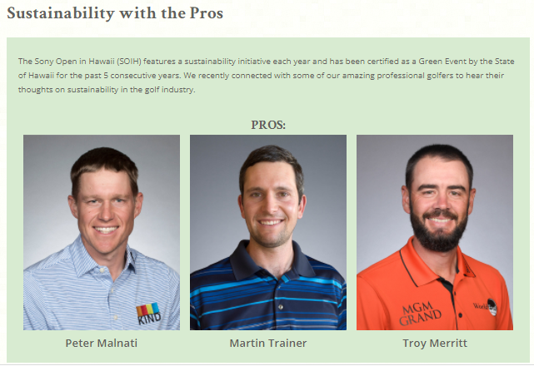
Raising awareness & reducing hard copies
Notes:
We focused our efforts to enhance the digital communication for the overall tournament as well as for sustainability initiative.
Tournament guide, various updates, and other communication were provided digitally which helped us reduce the number of hard copies produced with the event.
Furthermore, the sustainability course map was developed, showcasing the integration of sustainability at Sony Open.
We connected with some of the amazing professional golfers to hear their thoughts on sustainability in the golf industry as well and made
the Sustainability with Pros article available on the website.
We proactively communicated about the sustainability to raise the public awareness while helping to reduce the use of natural resources at the event.

Slide 3
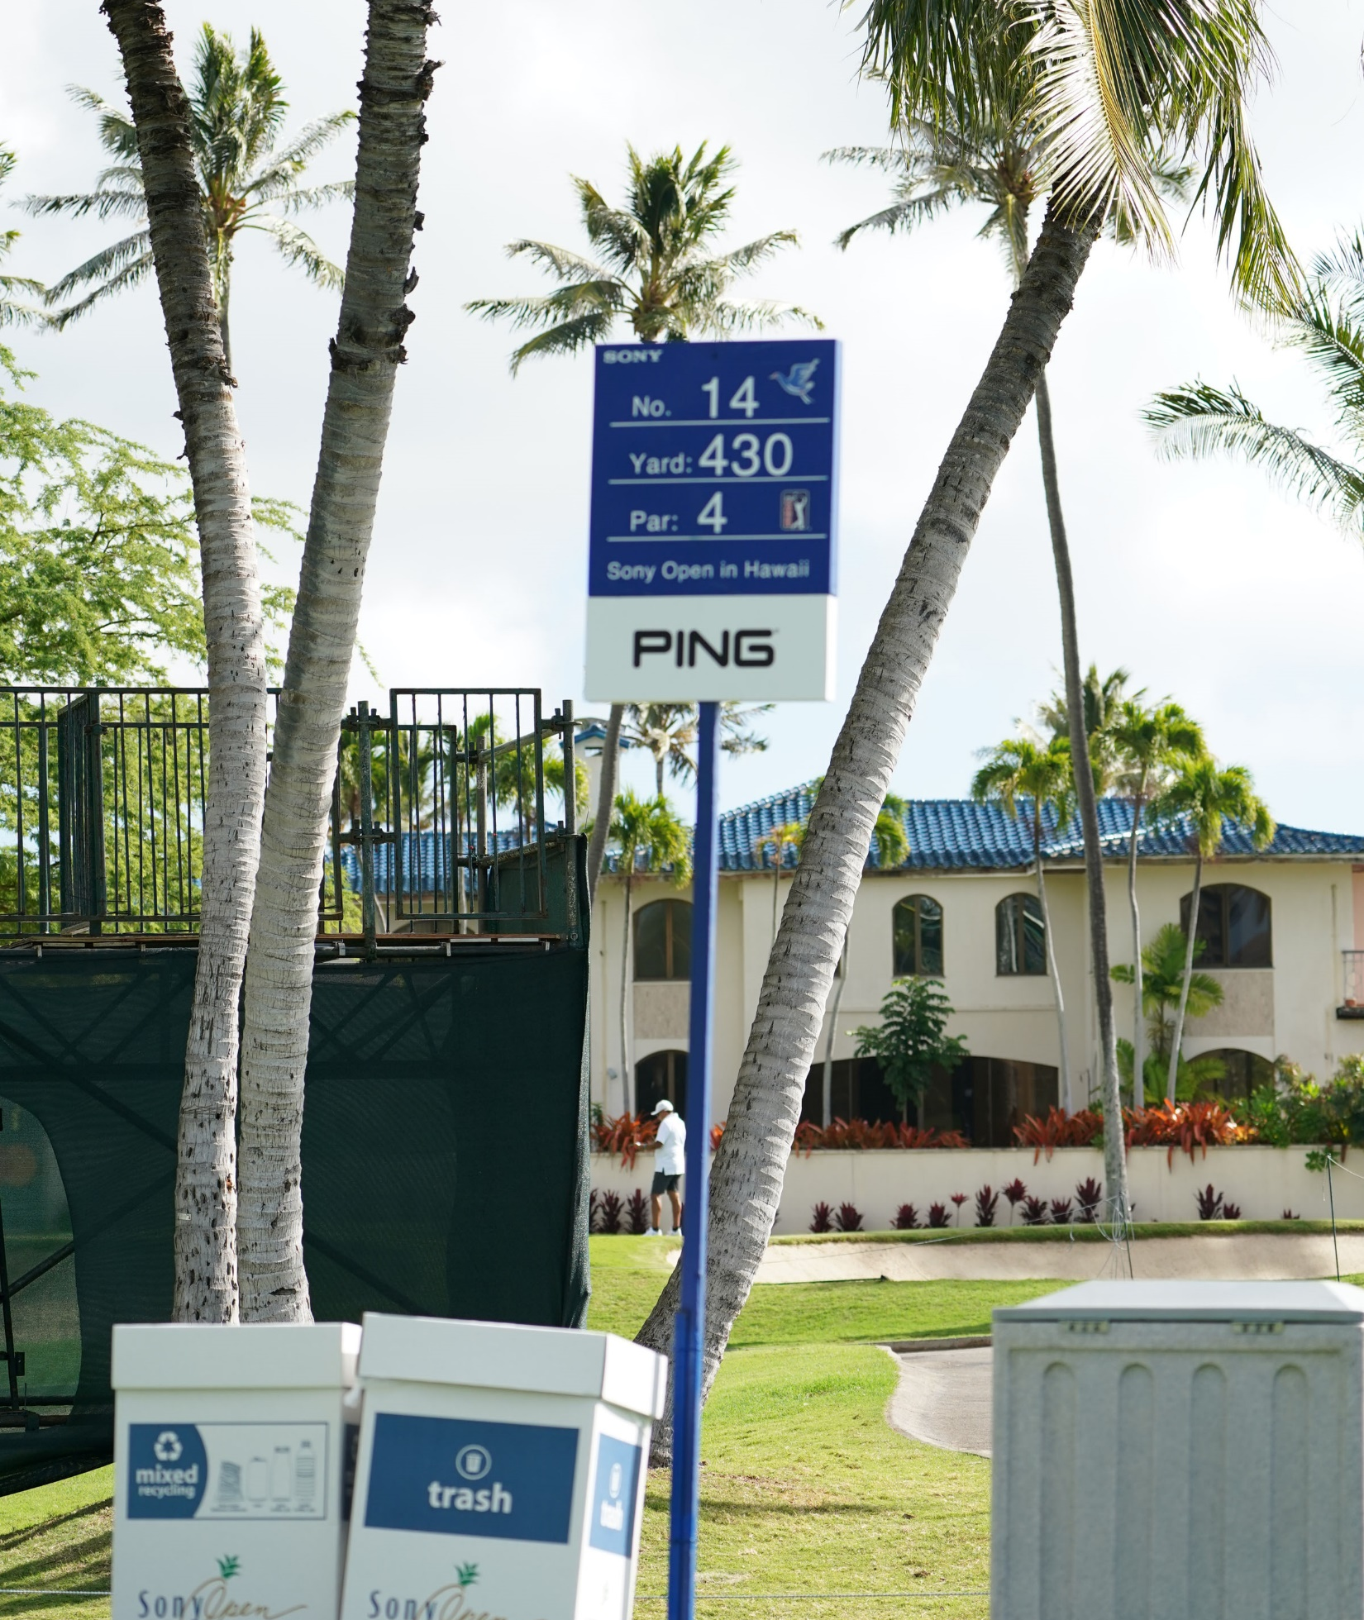
2021 Key Green Practices
Recycling receptacles
Hand-sorted waste recycling
Food wastes diversion
Reuse of materials from past events
No use of Styrofoam, plastic straws or coffee stirs
Use of compostable cups, take out containers and other materials
Carbon offset as part of the event’s carbon footprint assessment
At Waialae Country Club
  Solar panels
  Use of organic fertilizer on the golf course
  Use of non-toxic cleaners in the facility
Notes:
Sustainability has been a key part of the Sony Open and as a community-wide, charity event, the tournament galvanizes public and private sector volunteerism around green practices on multiple levels. Some of key green practices at 2021 event include:
Placement of recycling receptacles throughout the course and hand-sorting of wastes for recycling
Food wastes diversion for use at local piggery farms
Reuse of various materials from past events such as various sets and equipment for structures, including steel, wood, flooring, mesh and signage.
No use of Styrofoam, plastic straws or coffee stirs
Use of compostable cups, take out containers and other materials
Carbon offset as part of the event’s carbon footprint assessment
Solar panels on the club house, annex building, pro shop, and cart barn at Waialae Country Club
Use of organic fertilizer on the golf course and a non-toxic cleaner in the facility at Waialae Country Club
Despite the significant changes at the Sony Open in 2021, the team strived with the sustainability initiatives where feasible. We are proud to be doing our part to support Hawaii’s beauty and natural resources. We truly appreciate the recognition of Sony Open as a green event. Mahalo.

